Slide 1
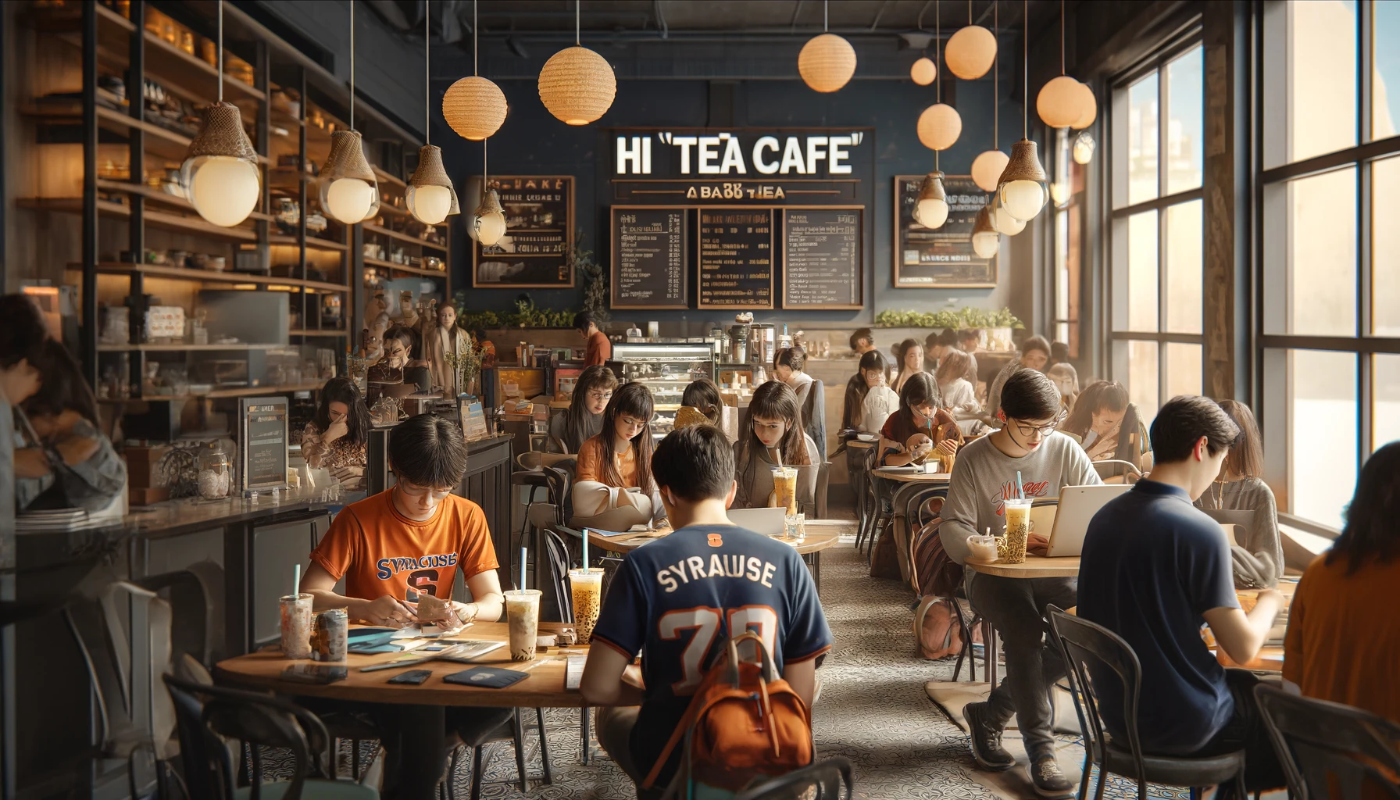
MAR 600 : Digital Marketing Analytics
Final Project
Submitted by: Prasun Abhishek | Akshay Ghuge
Priyamvada Barve | Nandita Pathardikar

Slide 2






CLIENT OVERVIEW AND RESEARCH MOTIVATION
Hi-Tea Cafe is known as a popular spot in Syracuse, especially among students. It's often described as a place that serves a variety of drinks like bubble tea, which is a Taiwanese tea-based drink that includes chewy tapioca balls or a wide range of other toppings. Besides bubble tea, it also serves Fresh Fruit Tea, Milk Foam Tea, and Smoothies.
Location : 113 Marshall St Syracuse, NY 13210
Industry : Food and Beverages
Founded : 2016
Rebranded : 2022
Company Size: 2-10 employees
Social Media Presence across Instagram, Commercial Website and LinkedIn, Facebook
Contact info : 315-901-2990, hiteasyracuse@gmail.com

Slide 3
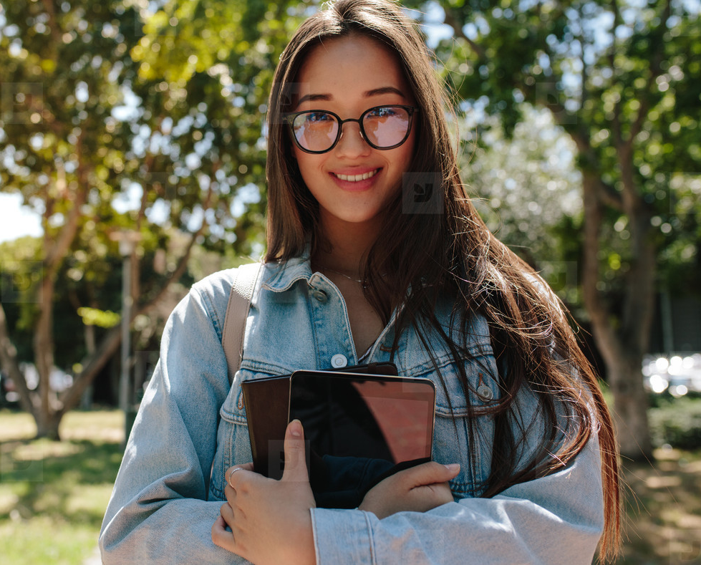

HI TEA CAFÉ TARGET MARKET
Name | Emily
Age | 22-year old
Occupation | Masters Student at SU
Relationship Status | Single
Goals | To enjoy trendy and delicious drinks while socializing with friends. Keep up with popular and Instagrammable food and beverage spots.
Hobbies | Sports, blogging, photography, exploring new food spots
Pain Points | Limited budget, seeks value for money, and long queues at popular spots
Other | Is environmentally conscious and appreciates eco-friendly packaging and initiatives.
Name | Michael
Age | 35-year old
Occupation | Working Professional, earns 80,000$/yr
Relationship Status | Married, father of two
Goals | To find a quick and relaxing getaway during breaks; a place that offers a quality, refreshing beverage and can also cater to organize meetings with stakeholders and team members
Hobbies | Golf, reading business journals, content blogging
Pain Points | Needs a quiet but accessible spot for quick meetings or to unwind, with offerings suitable for both adults and kids
Other | Tea lover and prefers options with nutritional information available.

Slide 4
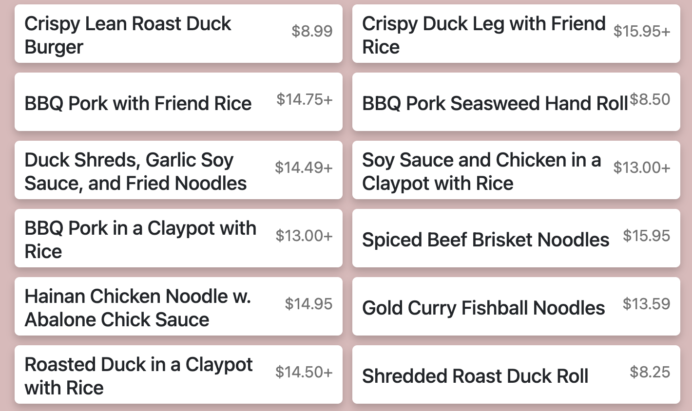
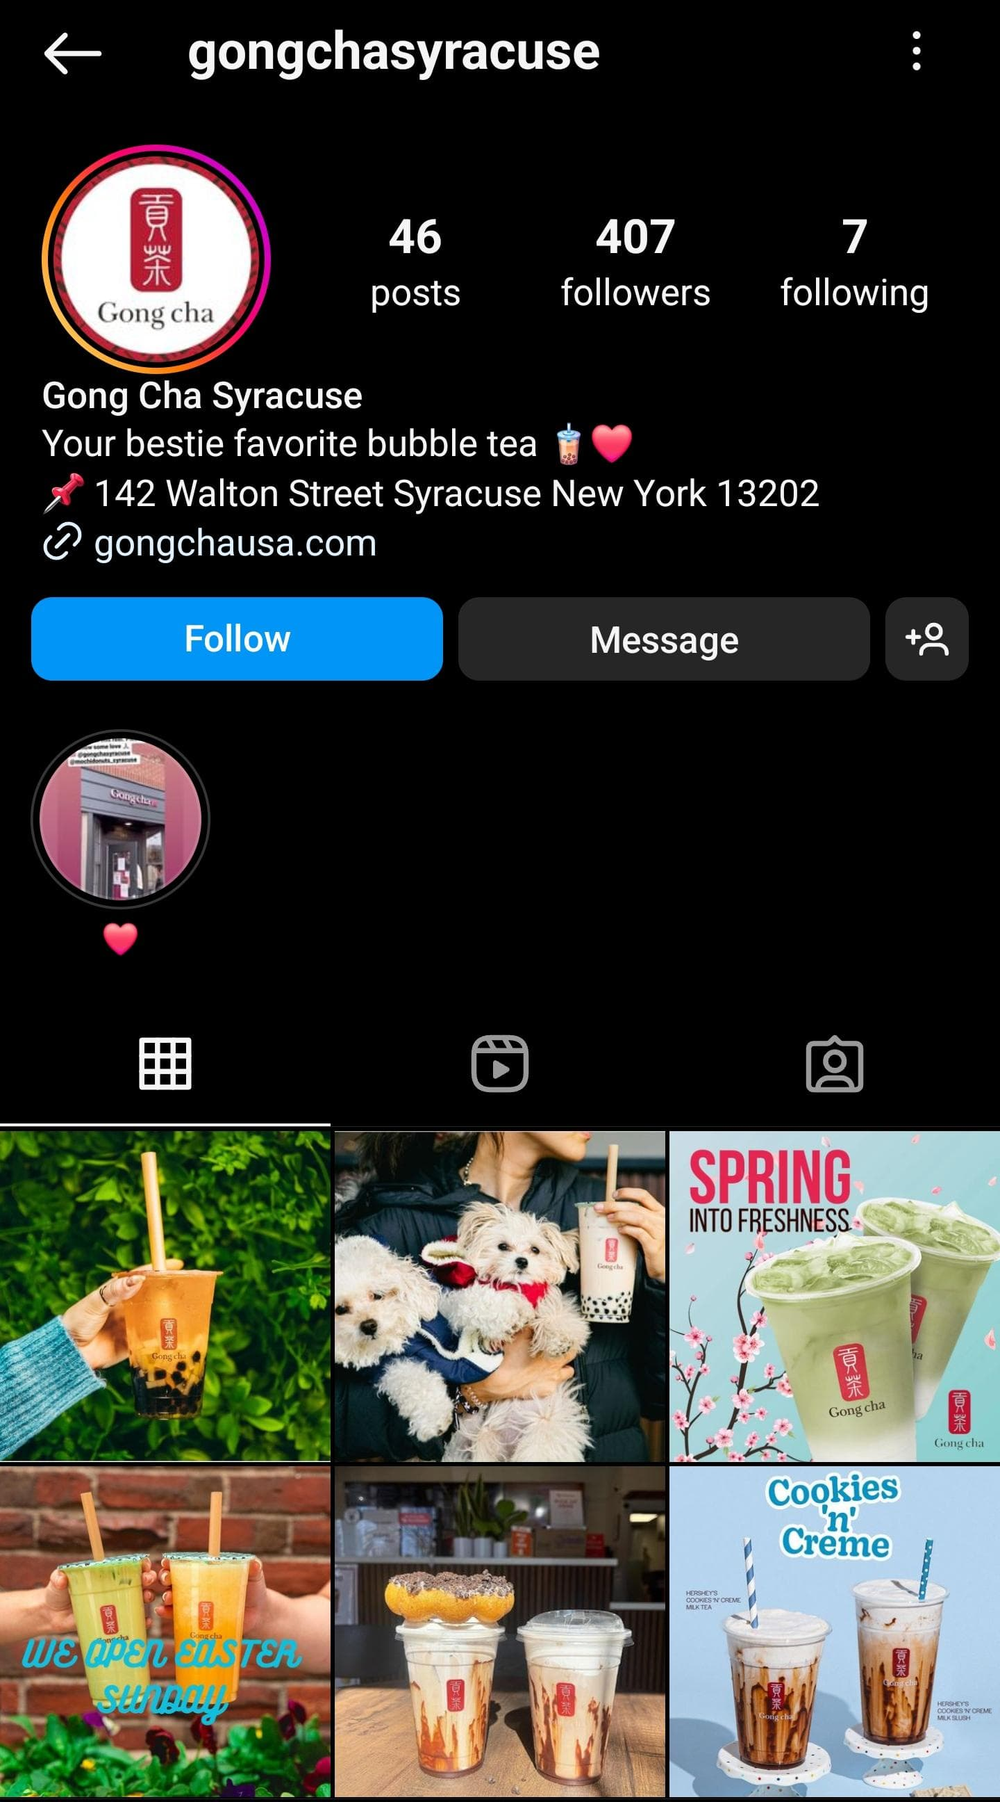
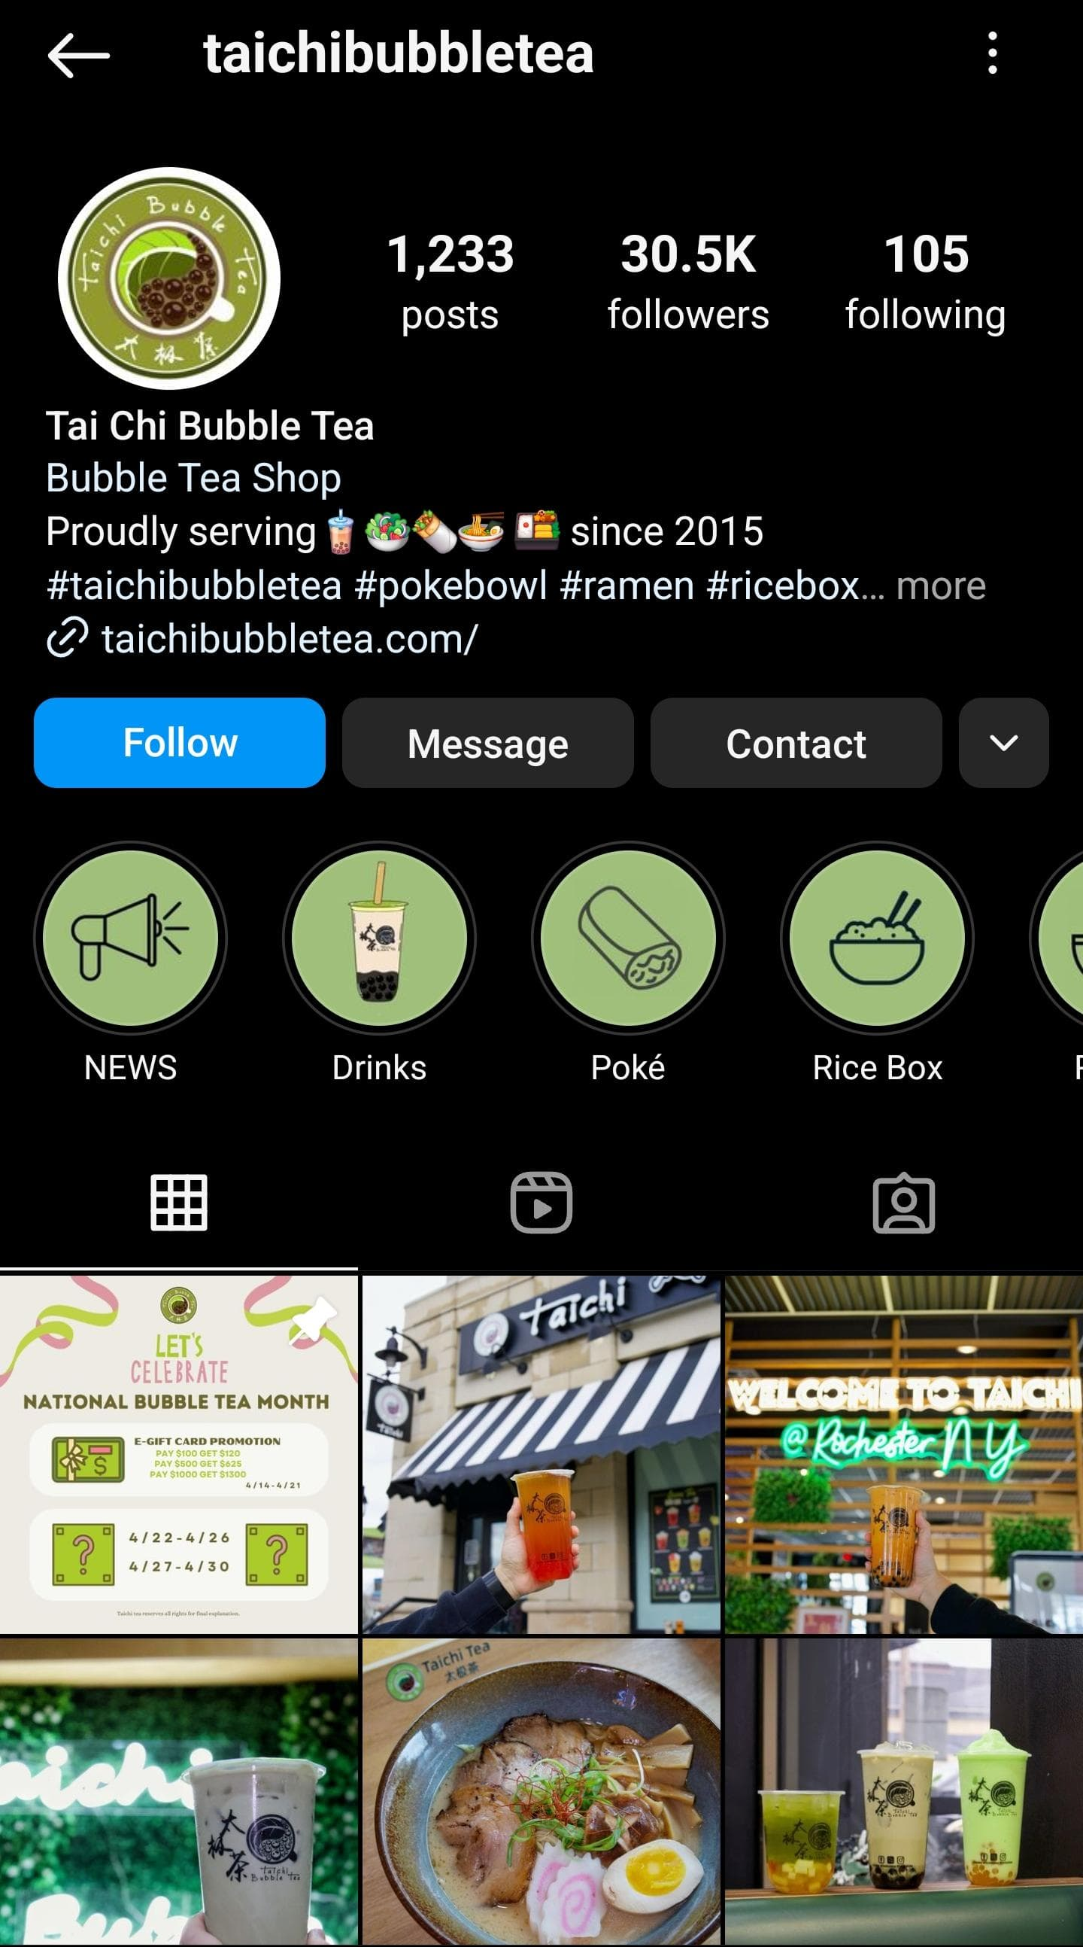
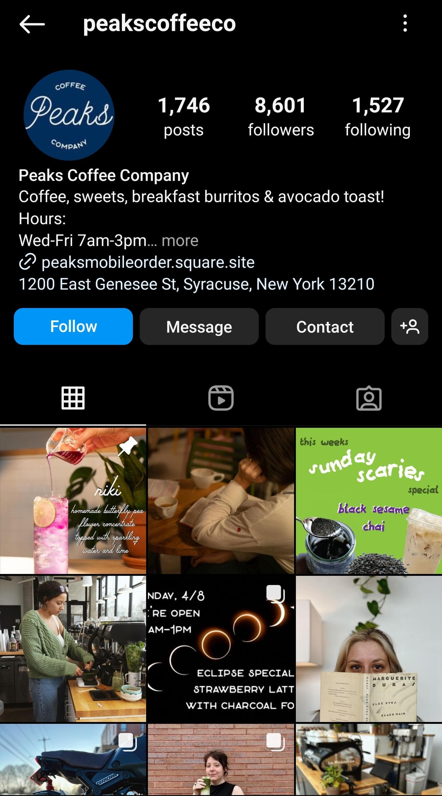
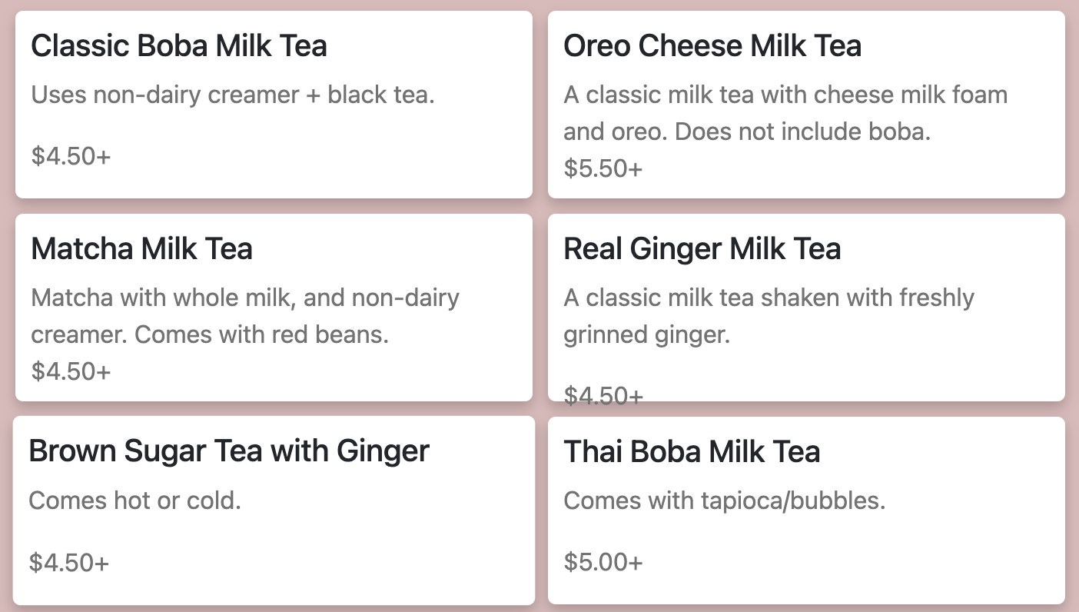
Research Motivation: Focus on Instagram
Brand Strategy Evaluation: Analyzing Hi Tea’s branding, such as its social media presence, as seen in the screenshot, can reveal the effectiveness of its strategies and offer lessons on building brand loyalty and engagement.
Brand Image and Identity: Examine the brand image and identity in motivating consumer behavior. A strong brand identity can evoke emotions and create a sense of belonging, which motivates consumers to engage with a brand.
_____________________________________________________________________________________________________________________________________
Current and Potential Competitors: Faces competition from GongCha, Taichi, and Peaks Coffee, which also offers a selection of bubble tea, coffee, and food options.
Market Position and Unique Selling Points: Hi Tea’s diverse menu positions it uniquely, catering to a broad taste palette.
Competitors - Digital Presence: Gongcha, Tai Chi Bubble Tea, Peaks Coffee Co.

Slide 5
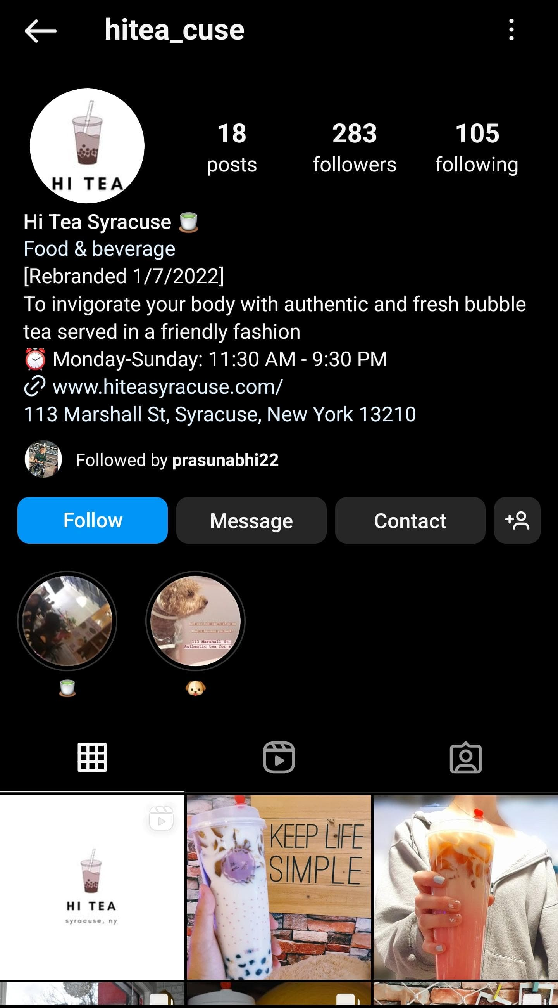
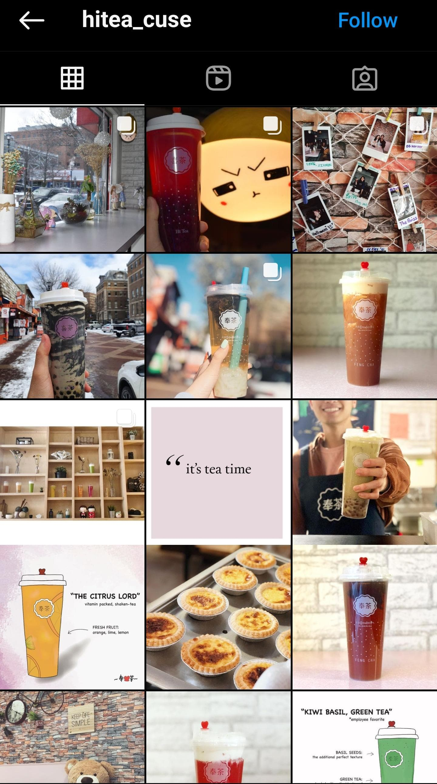
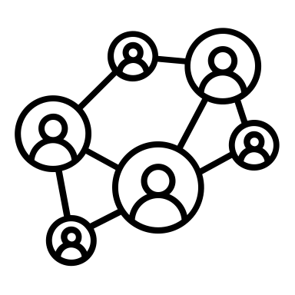


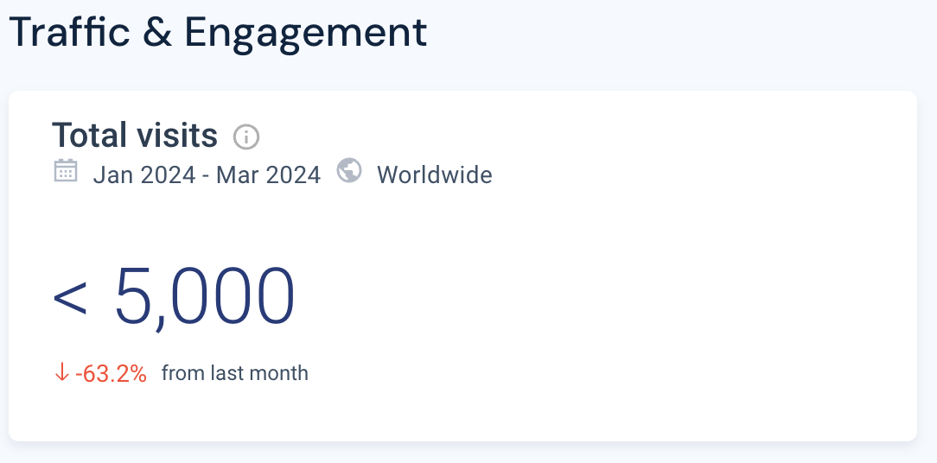
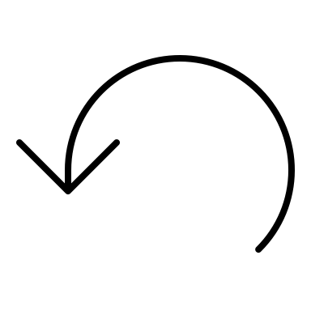
OVERVIEW OF DIGITAL MARKETING EFFORTS
Focus on Instagram: Most active social media platform
Lack of variety and customer-focused content involvement
Pictures of only bubble tea, no content where we
could see people enjoying their services and food.
Have been inactive for more than a year (last post was made in March 2023)
Lacks interactive content strategies: polls, votes, Q&As, and short format content (reels, stories)
Followers: 283
Total Posts: 18
Interactivity:
<100 likes per post
Website Traffic and Engagement

Slide 6
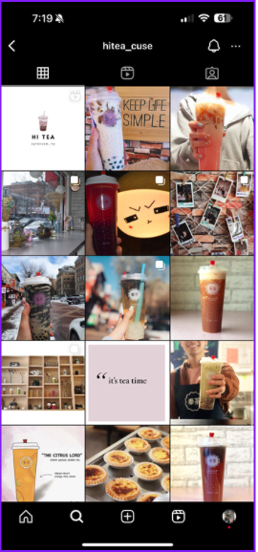
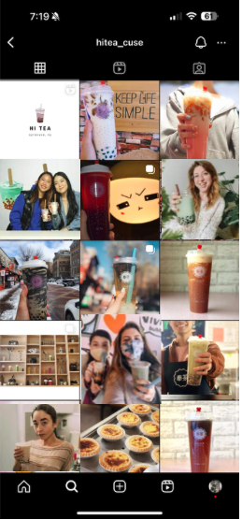
Research Question?
“Can adding Humans into HiTea” Instagram page improve
1) Frequency of visits to HiTea
2) Willingness to buy the items on the Instagram
3) Influence Bubble Tea preferences?
4) Amount of followers on Instagram account
CONTROL GROUP
Focused on Drinks and Food
EXPERIMENTAL GROUP
Human inclusive feed

Slide 7
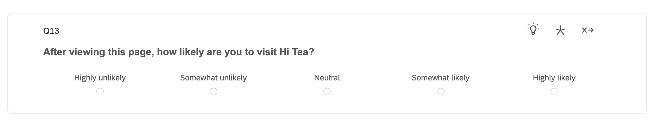
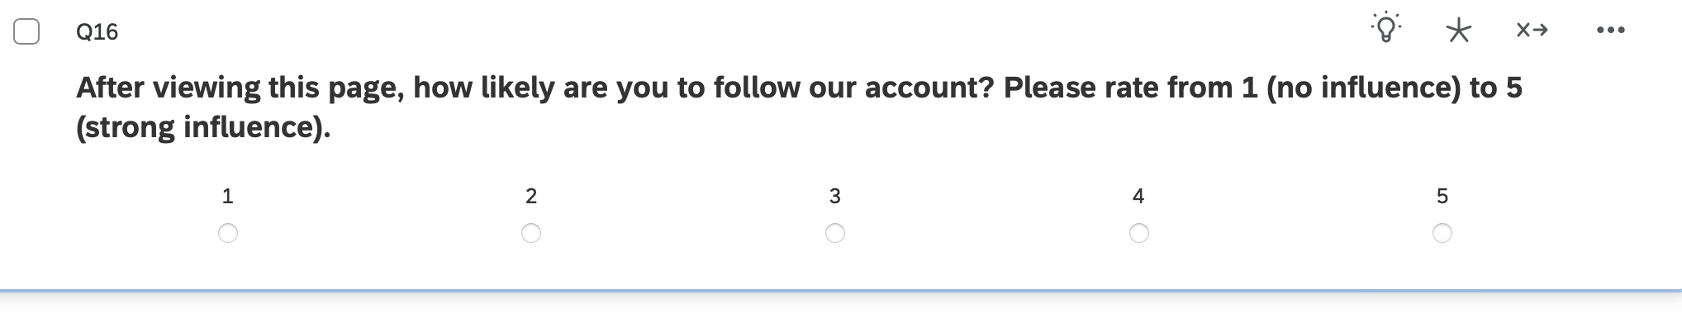
Survey Overview
Survey timeline: 3/21 – 4/2
Respondents : 146
Number of Questions: 18
Key dependent variables:

Slide 8
Survey Respondents

Slide 9
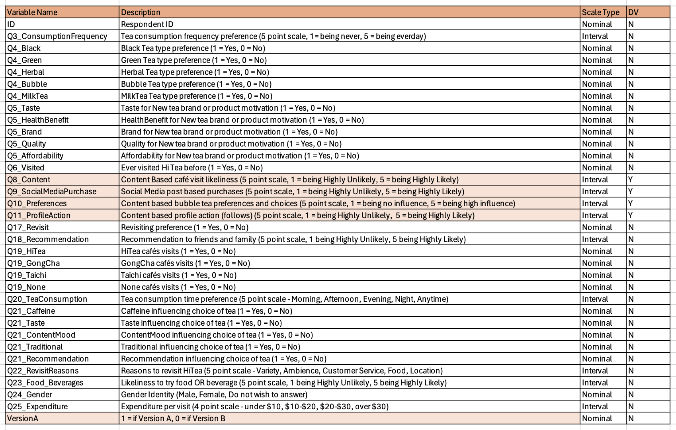
Codebook

Slide 10
Descriptive Stats

Slide 11
Randomization Checks

Slide 12
Does Version B work Better than Version A ?
Version B (Human Inclusive) engages audiences more than Version A (Food & Drinks Oriented)
More likely to visit, purchase & follow.
3 outcome variables are significant at the 0.15 level.
This is based on 5-point scale from “Highly Likely” to “Highly Unlikely”.

Slide 13
Regression Model
P-value < 0.15

Slide 14
Summarizing the main effects ?

Slide 15
Visualizing the interaction effects of Gender
Do males tend to follow HiTea more after looking at Version A than Version B compared to Females ?
Follow = Intercept*0.748511302 + Q18_Recommendaton*0.300741432 + Version B*0.413946449 + Q3_Consumption Frequency*-0.0565133 + Q4_Bubble*0.491034662 + Q4_MilkTea*-0.103228798 + Q5_Taste*-0.105921081 + Q5_Quality*-0.169985812 + Q6_Visited* 0.20987732 + Q17_Revisit*1.061981141 + Q20_TeaConsumption*0.01445299 + Q21_Taste*-0.059323212 + Q21_Traditional*0.122843676 + Q22_RevisitReasons*0.042636429 + Q23_Food_Beverages*0.169966051 + Q24_Gender*0.084753385 + Version B * Gender *-0.695339245
Here we observe that Males are likely to follow the HiTea account after looking at Version B whereas females are likely to follow after looking at Version A.
This can be seen while comparing the lift, male respondents show a positive lift of 14%, but female respondents have a lift of -16% which means Version A worked better for them.
 | Version A | Version B | Lift %
Male | 2.05 | 2.33 | 14%
Female | 2.49 | 2.08 | -16%

Slide 16
Visualizing the interaction effect of Revisiting
Do people who are revisiting Hitea, react to Version A differently than Version B compared to people who have never visited HiTea before?
Visit = 1.203901*Intercept + 0.221806*Q18_Recommendation + 0.367173*Version B - 0.006180*Q3_Consumption Frequency - 0.014014*Q4_Bubble + 0.203453*Q4_MilkTea + 0.174850*Q5_Taste + 0.237445*Q5_Quality - 0.159109*Q6_Visit + 0.460388*Q17_Revisited - 0.023250*Q20_TeaConsumption - 0.183757*Q21_Taste + 0.055692*Q21_Traditional + 0.029634*Q22_RevisitReasons + 0.295716*Q23_Food_Beverages-0.289466*Q24_Gender - 0.235287*Revisited*Version B
Both people who are revisiting and people who didn’t visit HiTea are likely to visit HiTea after looking at Version A.
People who have visited once and want to revisit HiTea don’t seem to care if they are looking at version A or version B as evidenced by the lift of -6%, although version A is slightly better than Version B.
People who haven’t visited HiTea seem to prefer Version A more than Version B, with a lift of -17%.
 | Version A | Version B | Lift %
Revisit | 2.34 | 2.21 | -6%
No Visit | 2.11 | 1.75 | -17%

Slide 17
Visualizing the interaction effects of Gender
Are males & females influenced by HiTea more after looking at Version A or Version B?
Influence = Intercept*1.655994587 + Q18_Recommendation*0.509924676 + Version B*-0.302614181 + Q3_Consumption Frequency*0.031193851 + Q4_Bubble*0.295473294 + Q4_MilkTea*-0.214347771 + Q5_Taste*-0.217859156 + Q5_Quality*0.000516217 + Q6_Visit*-0.168358821 + Q17_Revisited*0.595225696 + Q20_TeaConsumption*-0.05099852 + Q21_Taste*-0.503967478 + Q21_Traditional*-0.220450984 + Q22_RevisitReasons*-0.0385123 + Q23_Food_Beverages*0.038358451 + Q24_Gender*0.058491939 + Version B*Gender*0.266968992
Here we observe that Males & females are more likely to follow the HiTea account after looking at Version B compared to Version A.
This can be seen while comparing the lift, male respondents show a positive lift of 2%, and female respondents have a lift of 22% which means Version B worked better for them.
 | Version A | Version B | Lift %
Male | 1.74 | 1.77 | 2%
Female | 1.37 | 1.67 | 22%

Slide 18
Summarizing the interaction effects
Females tend to react positively towards Version A (product-oriented) and Males tend to follow Version B (Human Inclusive).
People who have visited HiTea and want to revisit HiTea, don’t care too much about the Instagram page, they are likely to visit the place anyway.
People who have never visited HiTea seem to be fascinated by the food and beverages on the Instagram account, as they are likely to visit after seeing Version A.
People who want to purchase Food and drinks from HiTea tend to positively react towards Version B (Human Inclusive) than to Version A (product-oriented).

Slide 19
Recommendations and Conclusion
HiTea can benefit from targeting new customers because once people visit Hitea our data suggests that they will want to revisit no matter the content on HiTea’s Instagram account.
Overall, we see that Version B (Human Inclusive) works better than Version A for people to follow and visit HiTea, therefore HiTea should make their Instagram page more human-inclusive.
Since HiTea is ideally located near the university, they should attract student customers through offers and promotions in university events.
HiTea can in general just benefit from posting more on Instagram, as their content is very less right now.
HiTea has great potential for customers only if they get to know about HiTea.

Slide 20
